Slide 1
Object-Oriented Data Modeling
Introduction
UML Language
Object-Oriented Modeling
Object Modeling Example
Transform Class Diagram to Relational Database Schema

Slide 2
Introduction
Object-oriented data modeling, used in conceptual design, is becoming increasingly popular because of its ability
- to represent complex relationships
- to represent data and data processing in a consistent notation.
This data model includes many concepts similar to those used in ER model, and other modeling facilities covered by UML.
An object-oriented model is built around objects, just as the ER model is built around entities. An object encapsulates both data and behavior.

Slide 3
This approach allows: data modeling and process modeling.
Other advantages:
- inheritance
- code reuse
Phases of object-oriented systems development cycle:
Analysis
Design
Implementation

Slide 4
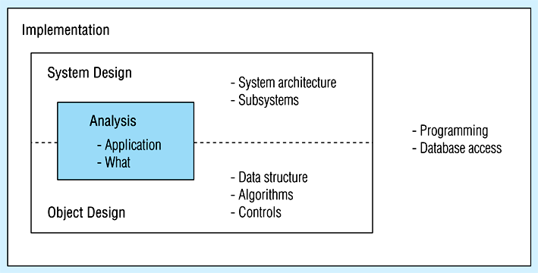
Phases of object oriented modeling development

Slide 5
Benefits of object-oriented modeling
Ability to tackle challenging problems
Improved communication between users, analysts, designers and programmers.
Increased consistency in analysis and design
Robustness of systems
Reusability of analysis, design and programming results.

Slide 6
Challenges in ER model design?

Slide 7
Benefits of OO Modeling (cont.)
• ERD and DFD (data flow diagram)
During developing DFD, designers have to include so many irrelevant details.
There are abrupt and disjoint transitions among different notations in ER approach.
• Object-Oriented approach provides a continuum of representation from analysis to design to implementation, enabling a smooth transition from one model to another.

Slide 8
The unified modeling language
UML is a notation/ a specification language that specifies software systems. UML comes from the efforts of three notations:
Booch (1994)
OOSE (Jacobson et al.) 1992
OMT (Rumbaugh et al.) 1991
UML notation is useful for graphically depicting an object-oriented analysis or design model.

Slide 9
UML (cont.)
UML allows us to represent different views about a system by providing many different diagrams:
- use-case diagram
- class diagram
- state diagram
- interaction diagram
- component diagram
- deployment diagram
In database conceptual design, we’ll need only class diagram to represent data and operations of a system.

Slide 10
Object-oriented data modeling
Representing Objects and Classes
Object: An entity that has a well-defined role in the application domain as well as state, behavior and identity.
- tangible: person, place or thing
- concept or event: department, marriage, registration
Objects exhibit BEHAVIOR as well as attributes.
State: attribute types and values
Behavior: how an object acts and reacts.

Slide 11
Behavior is expressed through operations that can be performed on it.
Identity: every object has a unique identity even if all of its attribute values are the same.
For example, if there are two Student instances with identical values for all the attributes, they are still two different objects.
An object maintains its own identity over its life time.
Object class: a set of objects share a common structure and a common behavior.
Example: STUDENT is an object class.

Slide 12
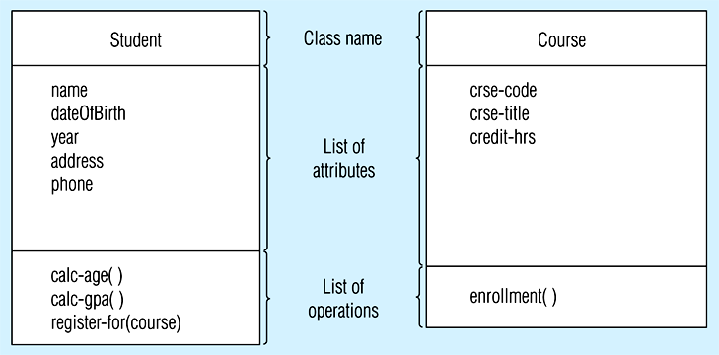
Class diagram: Shows the static structure of an object-oriented model: object classes, internal structures and relationships .

Slide 13
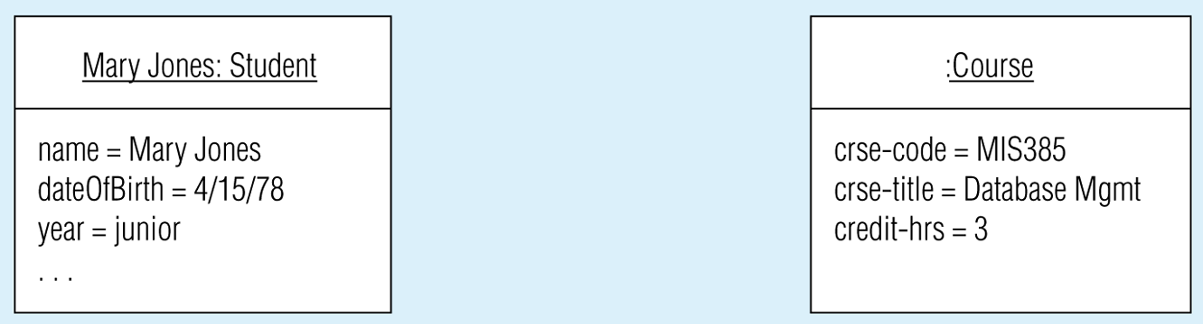
Object diagram: shows instances that are compatible with a given diagram.

Slide 14
Associations
Association: relationship among object classes.
Association role:
- Role of an object in an association
- The end of an association where it connects to a class.
Multiplicity
- How many objects participate in an association.
In a class diagram, a multiplicity specification is given as:
lowerbound .. upperbound

Slide 15
Examples:
0..*
0 ..1
1..*
1
*
2..6
1,3,5-7
Note: A binary association is bidirectional. The name of an association establishes only one direction.

Slide 16
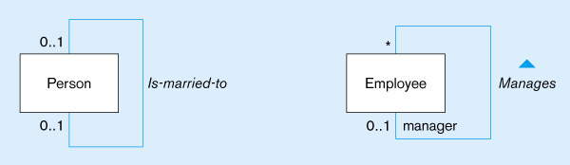
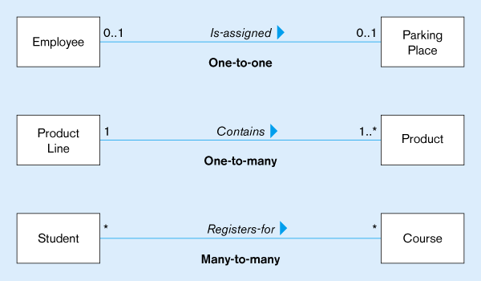
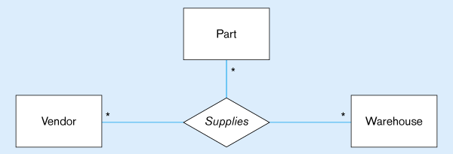
Lower-bound – upper-bound
Represented as:
0..1, 0..*, 1..1, 1..*
Similar to minimum/maximum cardinality rules in EER

Slide 17
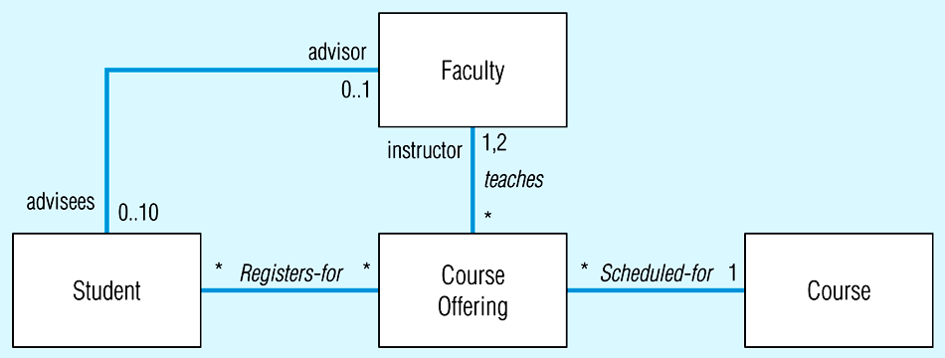
Examples of binary association relationships
(a) University example
Alternative multiplicity representation: specifying the two possible values in a list instead of a range

Slide 18
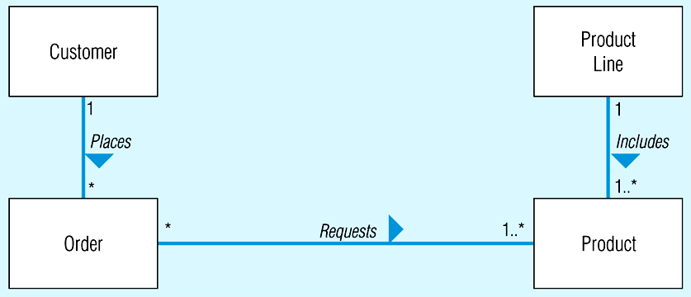
(b) Customer order example

Slide 19
Representing Association Classes
• An association that has attributes or operations of its own or that participates in relationships with other classes.
• Like an associative entity in ER model.

Slide 20
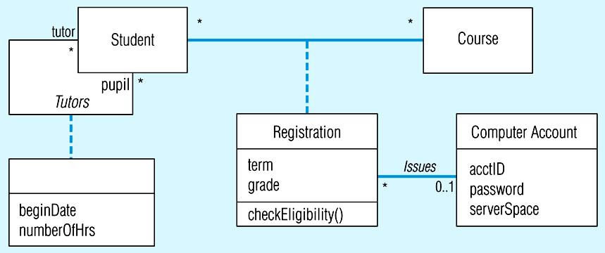
Association class and link object
(a) Class diagram showing association classes
Binary association class with behavior
Unary association with only attributes and no behavior

Slide 21
Association or Class
We have the option of showing the name of an association class on the association path, or the class symbol.
When an association has only attributes but does not have any operations or does not participate in other associations, we should show the name on the association path, to emphasize its “association nature”.
When an association has operations of its own, we should display its name in the class rectangle to emphasize its “class nature”.

Slide 22
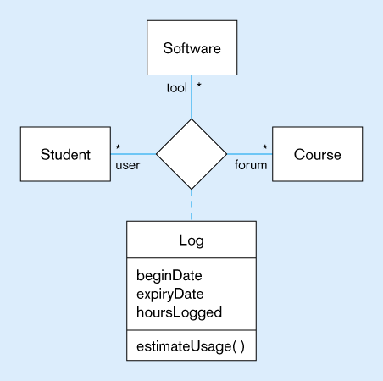
Ternary relationship with association class

Slide 23
Derived Attributes, Derived Associations and Derived Roles
A derived attribute, association or role is one that can be computed or derived from other attributes, associations, and roles, respectively.
A derived element is shown by placing a slash (/) before the name of the element.

Slide 24
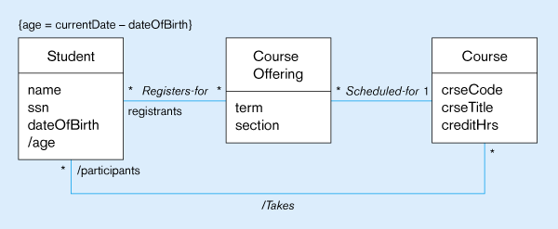
Derived attribute, association, and role
Constraint expression for derived attribute
Derived attribute
Derived relationship (from Registers-for and Scheduled-for)
Derived attributes an relationships shown with / in front of the name

Slide 25
Generalization/Specialization
Subclass, superclass
similar to subtype/supertype in ER
Common attributes, relationships, AND operations
Disjoint vs. Overlapping
Complete (total specialization) vs. incomplete (partial specialization)
Abstract Class: no direct instances
Concrete Class: direct instances

Slide 26
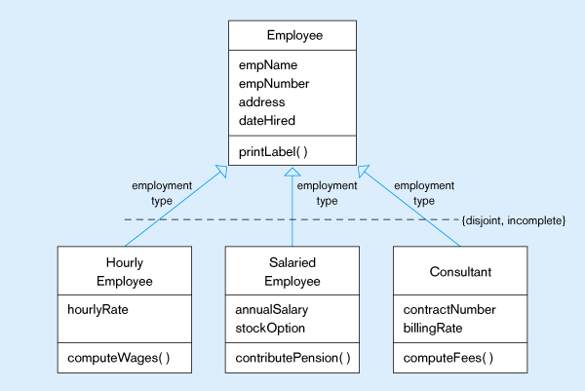
Examples of generalization, inheritance, and constraints
(a) Employee superclass with three subclasses
An employee can only be one of these subclasses
Shared attributes and operations
An employee may be none of them.
Specialized attributes and operations

Slide 27
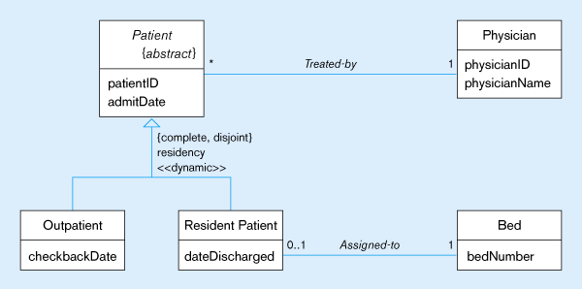
(a) Abstract patient class with two concrete subclasses
Abstract indicated by italics
A patient MUST be EXACTLY one of the subtypes
Dynamic means a patient can change from one subclass to another over time

Slide 29
Class-level attribute
Specifies a value common to an entire class,
rather than a specific value for an instance.
Represented by underlining
“=“ is initial, default value

Slide 30
Polymorphism
Abstract Operation: Defines the form or protocol of the operation, but not its implementation.
Method: The implementation of an operation.
Polymorphism: The same operation
may apply to two or more classes in different ways

Slide 31
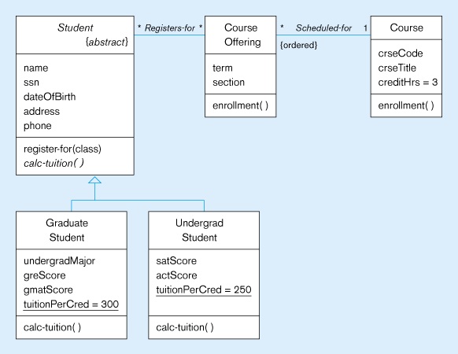
Polymorphism, abstract operation, class-scope attribute, and ordering
This operation is abstract…it has no method at Student level
Class-scope attributes – only one value common to all instances of these clases
Methods are defined at subclass level

Slide 32
Overriding Inheritance
Overriding: The process of replacing a method inherited from a superclass by a more specific implementation of that method in a subclass.
For Extension: add code.
For Restriction: limit the method.
For Optimization: improve code by exploiting restrictions imposed by the subclass.

Slide 33
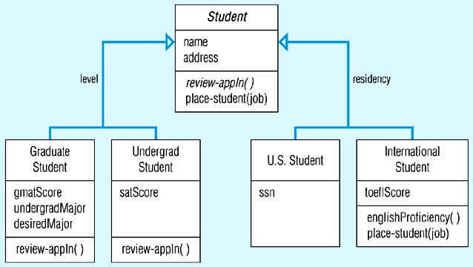
Overriding inheritance
Restrict job placement

Slide 34
Multiple Inheritance
Multiple Classification: An object is an instance of more than one class.
Multiple Inheritance: A class inherits features from more than one superclass.

Slide 35
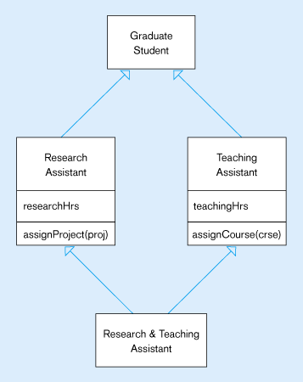
Multiple inheritance

Slide 36
Aggregation
Aggregation: A part-of relationship between a component object and an aggregate object.
Composition: A stronger form of aggregation in which a part object belongs to only one whole object and exists only as part of the whole object.
Recursive Aggregation: composition where component object is an instance of the same class as the aggregate object.

Slide 37
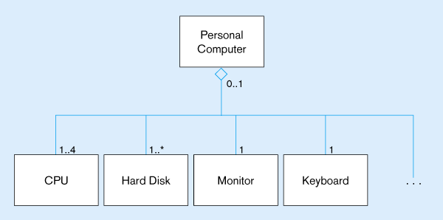
Example aggregation

Slide 38
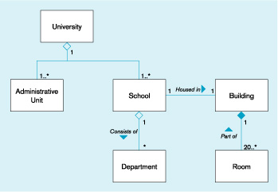
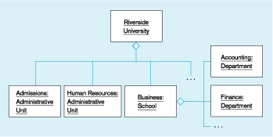
Aggregation and Composition
(a) Class diagram
(b) Object diagram

Slide 39
Specific examples of aggregation/composition?

Slide 40
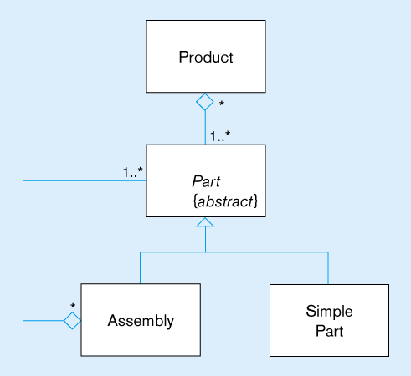
Recursive aggregation

Slide 41
Business Rules
Implicit and explicit constraints on objects – for example:
cardinality constraints on association roles
ordering constraints on association roles
Business rules involving two graphical symbols:
labeled dashed arrow from one to the other
Business rules involving three or more graphical symbols:
note with dashed lines to each symbol

Slide 42
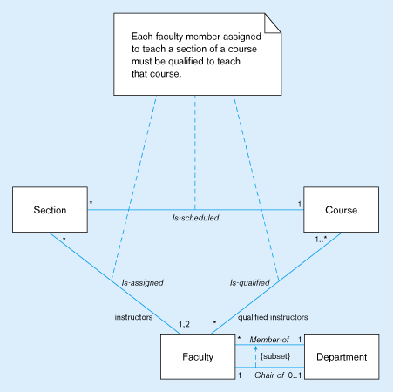
Representing business rules
Three-symbol constraint
Two-symbol constraint

Slide 43
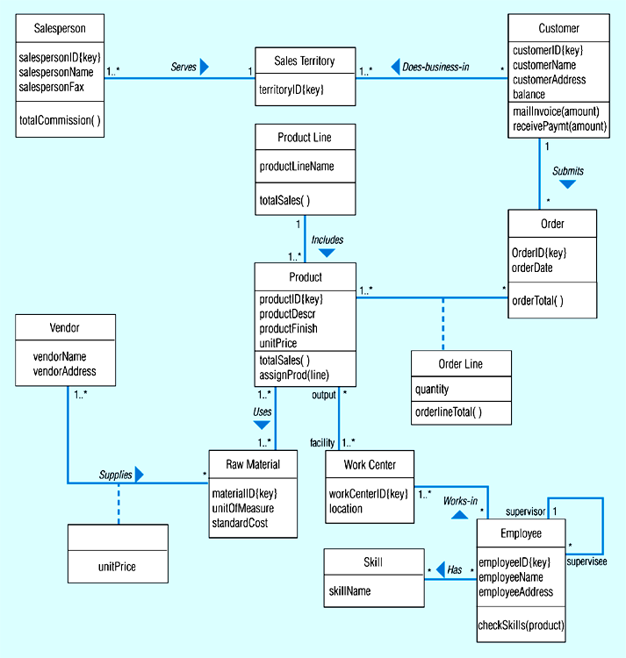
Class diagram for Pine Valley Furniture Company

Slide 44
Object modeling example: the pine valley furniture company
We do not have to put explicit identifiers for each class since each object will have its own object identity.
ER model and relational model use value-based identification (Explicit identification)
OO model uses existence-based identification
(Implicit identification)
In OO model, the identifiers that we should create are the identifier attributes that are meaningful in the application.
Example: Salesperson_ID, Customer_ID, …

Slide 45
And we should not create the identifiers that are not meaningful attributes in real life.
Example: ProductLine_ID, Vendor_ID, Skill_ID
Note: In a conceptual object-oriented model, an attribute should be single-valued. Therefore, a multivalued attribute should be transformed into a separate class and an 1:N association between the class and the new class.

Slide 46
Transform class diagram to relational database schema
In general, the transformation of class diagram to relational schema is similar to that of ER to relational schema, except some specific issues:
1. Transform a class in class diagram to a table
2. Transform an attribute of a class to a table column.
3. In case a class does not have any explicit identifier, create a primary key (usually of integer type) for the table corresponding to that class.
4. For a table corresponding to a subclass, use the primary key of its superclass as its primary key.

Slide 47
5. For a table corresponding to an association class, create a primary key for it. Put primary keys of the tables corresponding to the participant classes as its foreign keys.
6. For a component class in an aggregate association, its table takes primary key of the table corresponding to its aggregate class as a part of its primary key.
7. Transforming a binary or ternary association into a relational schema strongly resembles the transformation of the ER relationship.
8. Represent the operations of a class as stored procedures or functions. These functions/ procedures may contains some SQL commands.
9. There is no good way to represent multiple inheritance in a relational schema. Restructure the class diagram to avoid it.

